Slide 1
Project 2: The Supply-Bot
Vamshi Kalavagunta, Sameer Arjun S

Slide 2
Introduction:
Intelligent logistics is one of the most important developments to be made in the modern logistics industry to improve the efficiency of industries. Although conveyor belts and cranes can solve the logistic issues of a large-scale manufacturing plant, there is a need for flexible versatile mobility robots which can adapt to smaller and more flexible work environments without sacrifices in efficiency or performance.
This requirement is more important and relevant to the modern-day approach to manufacturing like micro factories or even large-scale warehouses. Because the upfront investment and capital involved in setting up conventional systems is very high and not flexible if there is a change in the type of product being used.
To work with such ever-changing needs, a robotic system flexible and accommodating enough for such requirements is needed, and our solution for this is the Supply-Bot. In the future, the combination of robotics, artificial intelligence and autopilot technology will greatly enhance the applications and capabilities of such a technology

Slide 3
Applications:
Warehouse: Material handling, storage and supply of components
Manufacturing: Applications in assembly operations and component assembly, which is particularly important in flexible manufacturing approaches
Conveyance Sortation: Diverts cases from a centralized conveyance system to different destinations such as gaylords, packing stations, or other process lines.
AMR/AGV: Utilizes autonomous vehicles, often located in a dedicated field, to sort pallets or pods of product for storage and retrieval.

Slide 4
Motivation:
By 2030, there will be over 4 million commercial robots installed in over 50,000 warehouses, up from just under 4,000 robotic warehouses in 2018 according to ABI Research. Warehouse robots are intelligent devices that automate inventory transportation around warehouses. They are improving processes with little human intervention. The early automation in warehouses focused on moving heavy objects in a restricted environment. However, in the recent several decades, innovation in robots, artificial intelligence, and the Internet of Things has skyrocketed. As a result, firms began to construct "smart warehouses.“
Our solution to this issue could be solved with the proposed robot 4 wheeled robot with a loading bed attached with elbow manipulator that is able to move easily in workplaces and warehouses comfortably to relocate, assemble or arrange the industrial raw materials in a hassle-free manner.

Slide 5
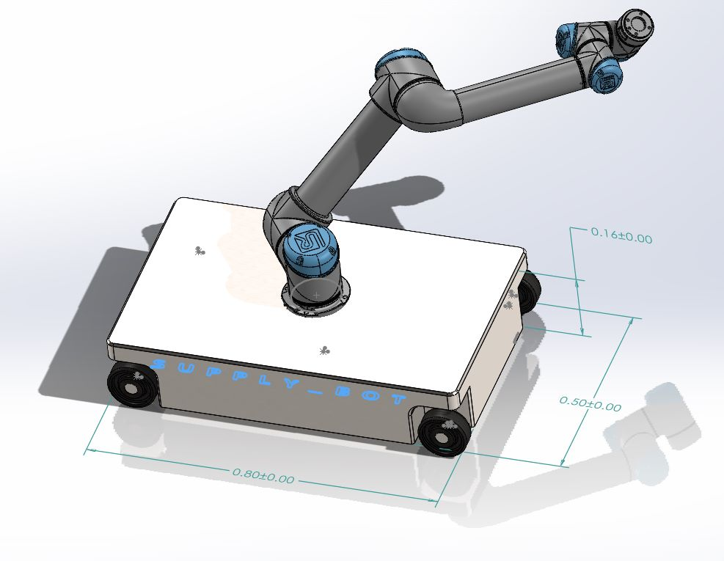
Cad model:

Slide 6
Robot description:
Specifications:
Topics | Descriptions
Robot base | Stainless steel chassis mounted on 4 wheels.
Robot manipulator | UR5 with 2 links and with 3 offsets.
Robot End effector | Suction gripper(Pneumatic type).
Navigation | Lidar
Dimensions | 0.8 x 0.5 x 1.1 meters
Robot Weight | 38.4 kg
Controllers | PID
Motors | Servo
DOF | 8

Slide 7
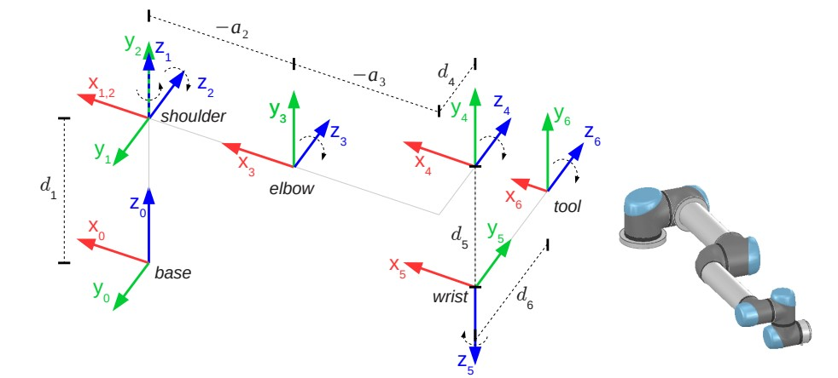
DH frames for UR5:
Reference: http://rasmusan.blog.aau.dk/files/ur5_kinematics.pdf

Slide 8
DH-table for the manipulator:
i | alpha_i | a | d | theta_i
1 | 0 | 0 | D1 | theta1
2 | 90 | 0 | 0 | theta2
3 | 0 | a2 | 0 | theta3
4 | 0 | a3 | d4 | theta4
5 | 90 | 0 | d5 | theta5
6 | -90 | 0 | d6 | theta6
d1=0.089159m, d4=0.10915m, d5=0.09465m, d6=0.0823m, a2=-0.42500m ,a3=-0.39225m

Slide 9
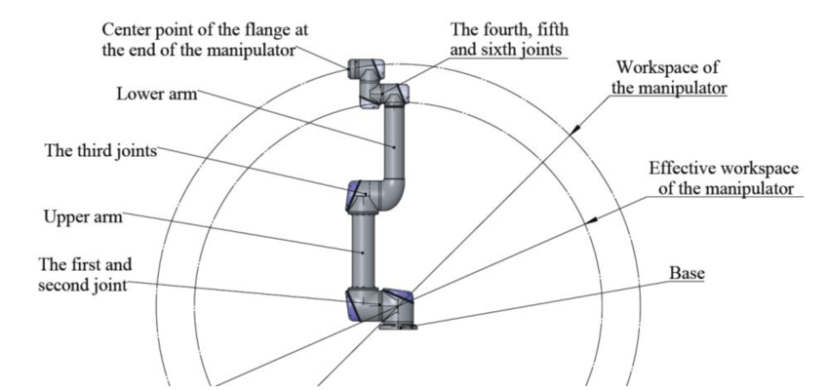
Workspace:
The Maximum reach of the end effector is 0.850 m
Reference: https://www.universal-robots.com/products/ur5-robot/

Slide 10
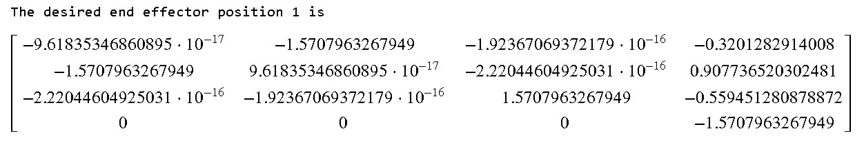
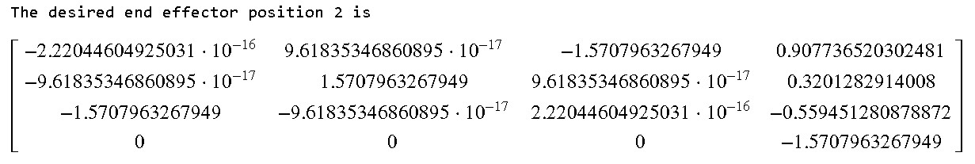
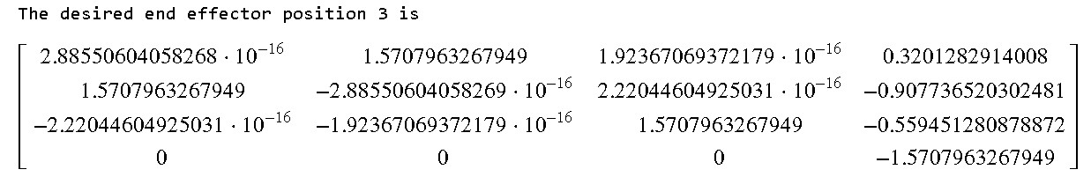
Forward Kinematics:

Slide 11
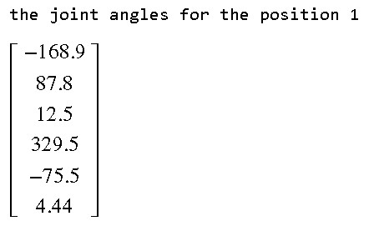
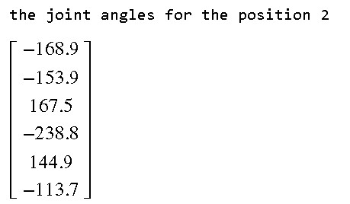
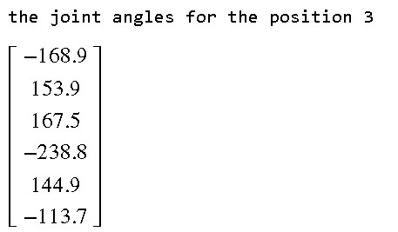
Inverse Kinematics:

Slide 12
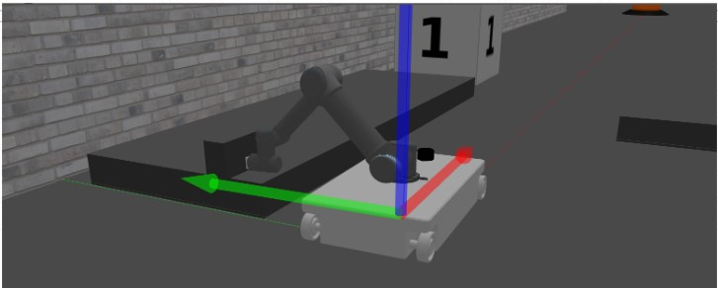
Supplybot pick and place visualization
Video: https://drive.google.com/drive/folders/1w-Pk6UuMPIZNaZHr0_zPXJYpi952FbNI?usp=share_link

Slide 13
Problems faced:
Issues were faced with addition of mecanum wheels to robot, because of which the same objective was achieved using robot with steerable system.
Integration of robot base with standard manipulator because of the variation of axes reference of both these systems, and the inertia of robot arm movement caused movement in base.
URDF integration with robot arm, gripper and sensor systems, and maintaining the suction force for vacuum gripper to retain object during motion
Calculation of forward and inverse kinematics for such a complex motion plan, since the desired trajectory is complex

Slide 14
Individual Contribution:
Cad modelling and urdf export [Sameer].
Sensor and end effector plug-in integration[Vamshi,sameer]
Implementation in ROS [Sameer, Vamshi]
Forward and inverse Kinematics calculations [Vamshi, Sameer]

Slide 15
Future scope:
Implementation of full autonomy using sensors for object avoidance.
Additional end effectors for the robot manipulator
Implementation of sensor systems on robot arm for additional capabilities.

Slide 16
Lessons learned:
To model a robot in CAD.
To export urdf and integrating sensors using Xacro file.
ROS, gazebo and rviz
Forward and inverse kinematics .

Slide 17
References:
Robot modelling and control by Mark. W .Spong.
http://rasmusan.blog.aau.dk/files/ur5_kinematics.pdf ( UR5 manipulator)

Slide 18
THANK YOU

